Slide 1
Week 5 Storytelling
DESN2000 Workshop
Design Next, workshop 5

Slide 2
Introduction
Whole class
In this workshop we’ll develop a short story which you could use at the start of your Design Presentation (20 %)
More broadly, the aim is to develop your storytelling skills so you can engage any audience with engineering, and get emotional buy in with your design problems and solutions.
Stories are an account of past or imagined events in someone’s life or in the development of something.
Introduction | Conflict | Exposition | Resolution | Practice and further reading
5 min | 20 min | 10 min | 10 min | 20 min
all | Individual | group | group | group

Slide 3
Introduction
Whole class
Exposition
background
Conflict
problem
Resolution
solution
Story arc
We’ll construct a short story using three components:
Exposition – Provides background information that the audience needs to understand the story you’re about to tell.
Conflict – The core of the story, what is the problem which must be overcome! Engage the audience on emotional and rational levels. Use characters to help build suspense and curiosity.
Resolution – How does your story finish! This should be linked your design solution, and give a sense of relief and excitement to the audience.
After this introductory story the audience should buy into your idea in principle… and it’s time to dig into the body of the presentation.
~ 1-minute
Introduction | Conflict | Exposition | Resolution | Practice and further reading
5 min | 20 min | 10 min | 10 min | 20 min
all | Individual | group | group | group

Slide 4
Housekeeping
Whole class
Today’s workshop will involve several individual and group activities. For the group activities you may use one of these visual tools to help you complete activities:
Miro or Google Jamboard you already know.
A shared document in Word/Google Doc can work for text content
Introduction | Conflict | Exposition | Resolution | Practice and further reading
5 min | 20 min | 10 min | 10 min | 20 min
all | Individual | group | group | group

Slide 5
Let’s start preparing our story by considering the problem
Exposition
background
Conflict
problem
Resolution
solution
~ 1-minute

Slide 6
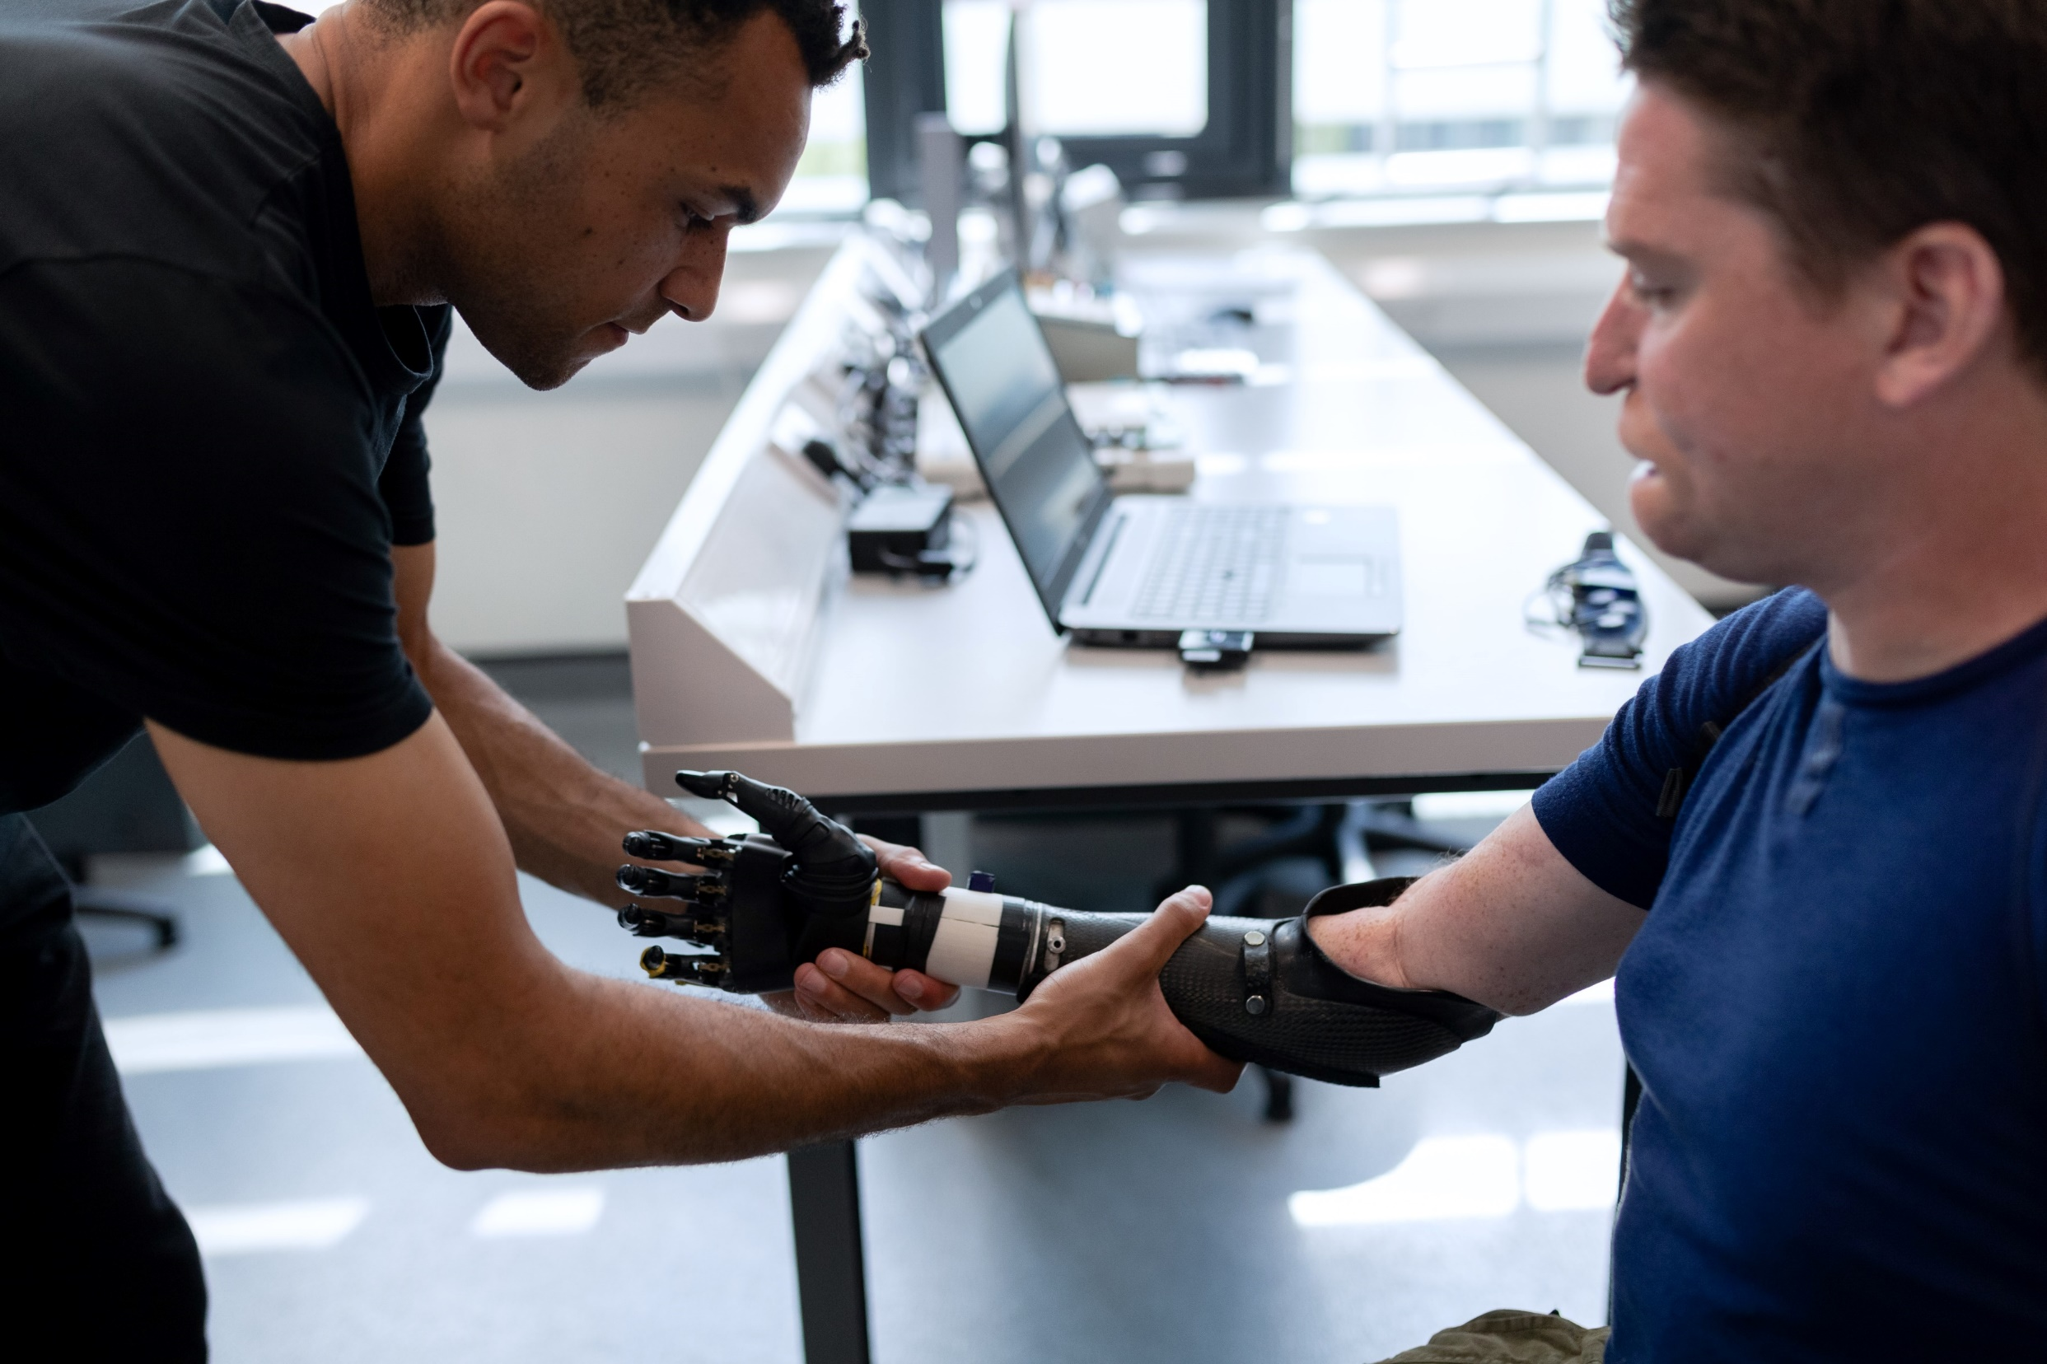
Conflict - Background
Whole class
Conflict is at the core of every story.
Think about your favourite movie, what kind of challenge did the main character overcome?
Engineering is about solving problems...
So conflicts are also at the core of engineering! Therefore, Engineers can leverage storytelling to present their problems in an interesting way.
Source: ThisisEngineering RAEng
Introduction | Conflict | Exposition | Resolution | Practice and further reading
5 min | 20 min | 10 min | 10 min | 20 min
all | Individual | group | group | group

Slide 7

Conflict - Background
Whole class
Stories are emotionally compelling if they focus on human impacts:
Who has the pain?
How bad is it for them?
What is your personal connection to it?
How does it affect broader communities/everyone?
What the harm in letting things continue this way?
Stories are more rationally persuasive if they use evidence. Once human impacts are established, back-up impacts with statistics or other data.
At the end of the conflict arc the audience should agree that your problem is important, widespread and urgent; and should be curious to hear your solution to it!
Source: Ben Hershey
Introduction | Conflict | Exposition | Resolution | Practice and further reading
5 min | 20 min | 10 min | 10 min | 20 min
all | Individual | group | group | group

Slide 8
Conflict – Individual brainstorm
Individual – 5 min
Individually list all the problems
associated with your project
What are the human pains for your project: user, customer, client or other stakeholders
What are potential impacts: economic, social and environmental
The aim here is QUANTITY, not quality. We’ll whittle down this list in the next activity, so for now engage your divergent mindset and see who can come up with the longest list in your team.
Do this task individually, as we’ll come together as a group in the next task.
Introduction | Conflict | Exposition | Resolution | Practice and further reading
5 min | 20 min | 10 min | 10 min | 20 min
all | Individual | group | group | group

Slide 9
Conflict – Group brainstorm
Group – 5 min
As a group collate everyone’s listed problems
and select one to focus your story on
Stories work better when they focus on one problem. When selecting which problem to focus on consider the following questions:
What were the similarities and differences between everyone’s listed problems?
Which problems do you think are the most rationally compelling? [Logos]
Which problems do you think are the most emotionally compelling? [Pathos]
Make sure the described problem is actually solved by your design in some way….
Introduction | Conflict | Exposition | Resolution | Practice and further reading
5 min | 20 min | 10 min | 10 min | 20 min
all | Individual | group | group | group

Slide 10
Now we have a our core conflict, let’s introduce it!
Exposition
background
Conflict
problem
Resolution
solution
~ 1-minute

Slide 11
Exposition - Background
Group
Briefly provide any background information that the audience needs to understand your story. For example:
Scope of the story… when/where
Who are the main characters… Is it you, someone you know, a well-known figure or a hypothetical person?
Historical context… is this the way things have always been done?
Definitions… are there any key term/jargon that need explaining? Aim to keep the language simple.
At the end of this phase, the audience should feel included, have all necessary insider knowledge and an understanding of what your talking about. They should also be excited to hear what comes next!
Introduction | Conflict | Exposition | Resolution | Practice and further reading
5 min | 20 min | 10 min | 10 min | 20 min
all | Individual | group | group | group

Slide 12
Exposition – Iteration cycle
Group
As a group go around a ‘circle’ and take turns trying to introduce your problem. Keep going until you are happy with the results!
Those watching the presenter should ask themselves the following questions:
Has enough information and explanation been provided for me to understand the story/presentation?
Am I intrigued to hear more? Is there some kind of interesting situation or character?
Is the exposition concise and to the point, is it free from confusing jargon?
Introduction | Conflict | Exposition | Resolution | Practice and further reading
5 min | 20 min | 10 min | 10 min | 20 min
all | Individual | group | group | group

Slide 13
Now it’s time to finish the story…
Exposition
background
Conflict
problem
Resolution
solution
~ 1-minute

Slide 14
Resolution - Background
Group
Briefly describe how your problem is solved, which should be related to your engineering design solution.
The aim is to get the audience to buy into your idea in-principle (i.e. they like it!)
After you've done this you can then dive into details of your presentation.
Introduction | Conflict | Exposition | Resolution | Practice and further reading
5 min | 20 min | 10 min | 10 min | 20 min
all | Individual | group | group | group

Slide 15
Resolution – Group brainstorm
Group
As a group briefly discuss potential resolutions
to the conflict described in the story
Consider the following questions:
Does the resolution provide a satisfying conclusion to the story?
Does the resolution relate to your engineering design solution?
Do you buy into the solution on an emotional and rational level?
Does the proposed solution actually solve the problem described in the story
Introduction | Conflict | Exposition | Resolution | Practice and further reading
5 min | 20 min | 10 min | 10 min | 20 min
all | Individual | group | group | group

Slide 16
Exposition
background
Conflict
problem
Resolution
solution
~ 1-minute
Now it’s time to bring it all together!

Slide 17
Story – Practice, practice… practice
TASK
Group
As a group take turns delivering your story in around 1-2 minutes.
Storytelling is more an artform than a science… so the best way to improve is by practicing
For the remainder of the class practice delivering your story to one another.
You may do this within your group, or practice with other groups in your class to get fresh feedback perspectives.
Review the resources on the following slide to fine tune your story… we’ve introduced one way to construct a story, but it is by no means the only way.
Introduction | Conflict | Exposition | Resolution | Practice and further reading
5 min | 20 min | 10 min | 10 min | 20 min
all | Individual | group | group | group

Slide 18
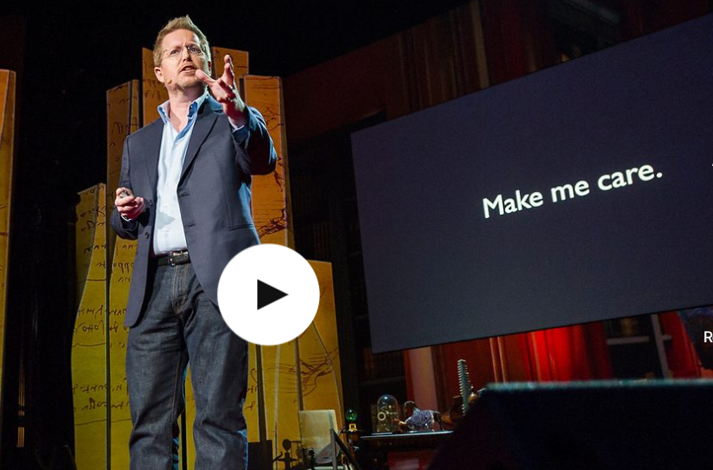
Resources
Whole class
Big Fish Presentations - The Building of Stories
Introduction on how to build a story [Skim read 5 minutes]
Harvard Business Review - How to Tell a Great Story
Quick tips on telling a great story [Skim read 5 minutes]
Andrew Stanton - The Clues to a great story
Importance of making the audience care [Watch 0:00 → 2:50]
David Philips - The magical science of storytelling
Importance of emotional investment [Watch 0:00 → 3:15]
Introduction | Conflict | Exposition | Resolution | Practice and further reading
5 min | 20 min | 10 min | 10 min | 20 min
all | Individual | group | group | group

